Slide 1
Lecture 9
Function

Slide 2
Function
Readability: sqrt(5) is clearer than copy-pasting in an algorithm to compute the square root.
Maintainability: To change the algorithm, just change the function (vs changing it everywhere you ever used it)
Code reuse: Lets other people use algorithms you’ve implemented.

Slide 3
Function Continued. (Syntax)
data_type func_name(arg 1, arg 2, … , arg n){
statement 1;
statement 2;
…
statement n;
return var_name; (optional)
}

Slide 4
Function Continued.
#include <iostream>
using namespace std;
int main() {
int threeExpFour = 1;
for (int i = 0; i < 4; i = i + 1) {
threeExpFour = threeExpFour * 3;
}
cout << "3^4 is " << threeExpFour << endl;
return 0;
}

Slide 5
Copy Paste Coding
#include <iostream>
using namespace std;
int main() {
int threeExpFour = 1;
for (int i = 0; i < 4; i = i + 1) {
threeExpFour = threeExpFour * 3;
}
cout << "3^4 is " << threeExpFour << endl;
int sixExpFive = 1;
for (int i = 0; i < 5; i = i + 1) {
sixExpFive = sixExpFive * 6;
}
cout << "6^5 is " << sixExpFive << endl;
return 0;
}

Slide 6
Using a Function
#include <iostream>
using namespace std;
// some code which raises an arbitrary integer
// to an arbitrary power
int main() {
int threeExpFour = raiseToPower(3, 4);
cout << "3^4 is " << threeExpFour << endl;
return 0;
}

Slide 7
Using a Function Continued.
#include <iostream>
using namespace std;
// some code which raises an arbitrary integer
// to an arbitrary power
int main() {
int threeExpFour = raiseToPower(3, 4);
cout << "3^4 is " << threeExpFour << endl;
int sixExpFive = raiseToPower(6, 5);
cout << "6^5 is " << sixExpFive << endl;
return 0;
}

Slide 8
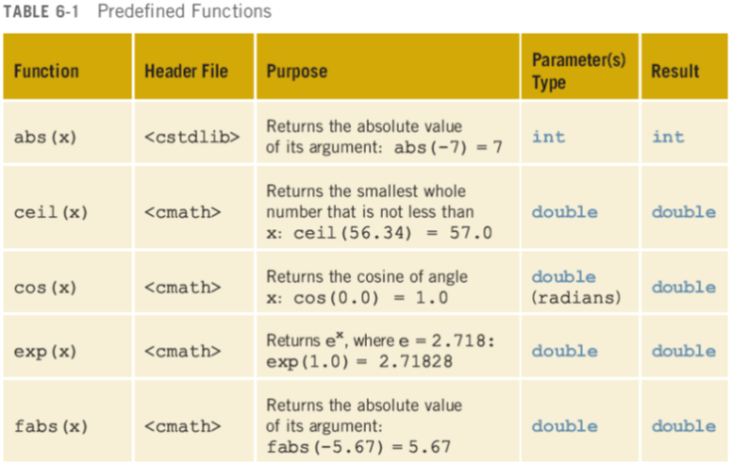
Predefined Function

Slide 9
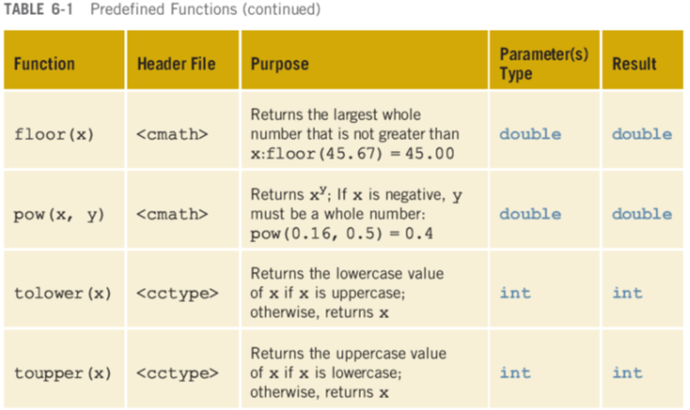
Predefined Function Continued.

Slide 10
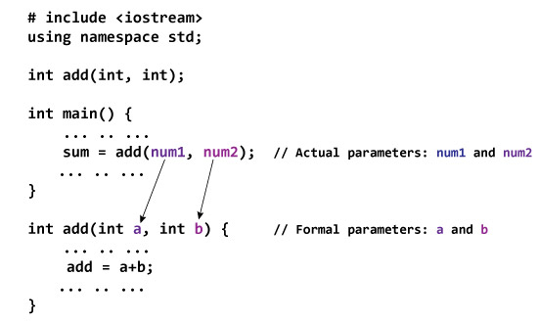
Order of Parameters

Slide 11
Examples of Valid Return Statements
return ‘a’; //value
return 0; //value
return a; //variable
return 5+4; //mathematical expression
return a-b; //mathematical expression
return x && y; //logical statements

Slide 12
Example of Invalid Return Statements
return a, b;
Return 2,4,8,x;

Slide 13
Problems
Write a program which will take an integer number as input and then call a function mySquare() to calculate and print its square value.
Write a function that will take a number as input and determine whether the number is prime or not.

